Slide 1
Lesson 2: Class diagram

Slide 2
Introduction
Class diagrams are the most commonly used diagrams in UML.
Class diagrams are for visualizing, specifying and documenting the system from a static perspective.
Class diagrams indicate which classes know about other classes and, if they do, what type of relationship exists.
Class diagrams will have different levels of detail (abstraction) depending on where we are in the software development process.

Slide 3
Student guide

Slide 4
Objectives
At the end of this lesson the student will be able to:
• Explain the features represented by a class diagram.
• Explain the relationships among different types of classes by means of association.
• Explain the relationships among different types of classes by means of aggregation.
• Explain the relationships among different types of classes by means of composition.

Slide 5
Topic 1: What is a class diagram

Slide 6
Class diagram
Class Diagram:
The main building block in object oriented modeling
describes the static structure of a system.
shows how a system is structured rather than how it behaves.
The static structure of a system comprises of a number of class diagrams and their dependencies.
Shows a set of classes, interfaces, and collaborations and their relationships : generalization, aggregation, association, and various kinds of dependencies.
Good way to describe the overall architecture of system components
used for both general conceptual modeling of the systematic of the application, and for detailed modeling translating the models into programming code
The classes in a diagram represent both the main objects and/or interactions in the application and the objects to be programmed
In the diagram these classes are represented with boxes which contain three parts

Slide 7
Class Diagram Perspectives
UML class diagrams can be used in three distinct ways depending on the phase of system development
Conceptual perspective
Used in Requirements phase
The diagram represents the problem that the software should solve
Classes are real-world concepts in the system's environment
Drawn with no regard for implementation (language independent)
Specification:
used to specify interfaces and classes that will be implemented in an object oriented program.
Models Classes in a software system, attributes, operations, associations, but no implementation details
Implementation
they can be used to show the architecture of the software by showing the relationships among different classes

Slide 8
Class Diagram Perspectives
Conceptual
Specification
Implementation
Student
Student
Student
name
major
GPA
standing
interests
name: String
major: String
GPA: real
standing: Scode
-major: String
-GPA: Real
-standing: String
add(Course)
drop(Course)
+add(Course)
+drop(Course)
-- The set of students known to the registration system
-- Handle a registration in
courses
-- Software representation of students; support registration in courses
0..1
1
CourseList
-- Display a dynamic list
courses
Increasing Detail
Real World Domain
Software Implementation

Slide 9
Class Diagram Essentials
A class diagram shows the existence of classes and their relationships in the logical view of a system
UML modeling elements in class diagrams are:
Classes, their structure and behavior.
relationships components among the classes like association, aggregation, composition, dependency and inheritance
Class diagrams can also show constraints on associations
Multiplicity and navigation indicators
Role names or labels.

Slide 10
Classes
A class
encapsulates state (attributes) and behavior (operations).
is a description of a set of objects that share the same attributes, operations, relationships, and semantics.
Graphically, is rendered as a rectangle

Slide 11
Class Notation
A class is depicted on the class diagram as a rectangle with three horizontal sections (“compartments”)
The upper section shows the class's name
The middle section contains the class's attributes, optionally with initial values
The lower section contains the class's operations or behaviors (methods)
May be abbreviated to show just name, or just name and attributes
Class Name
Attribute: Type =Initial Value
Operation(arg List): returnType
Notes:
Note that: The bottom two would be unnecessary on a diagram depicting a higher level of detail in which the purpose is to show only the relationship between classes.

Slide 12
Class Notation: example
Class
{
Flight
Expanded view of a
Class into its three
sections:
Top: Class Name
Middle: attributes
Bottom: operations
flightNumber: Integer
departureTime :Date
flightDuration : Minutes
attributes
{
delayFlight(In Number of minutes: minutes)
operations
Notes:
Here is the simplest possible class diagram
Figure shows an airline flight modeled as a UML class. As we can see, the name is Flight

Slide 13
Finding Classes
Where to find candidate classes:
Nouns in descriptions or conversation
Checklists of general/typical object types
Similar computerized systems
Technical literature in the problem domain

Slide 14
Example for Classes
Phenomena
Classes
Thing
Car, goods, packaging, materials
People & roles
Employee, parent, customer, member
Organizations
Company, department, group, project
Places
Shelf, parking spot, construction site, city
Concepts
Square, currency, quality parameters, fee
Resources
Money, time, energy,
labor force, info
Apparatuses
Radar, sensor, valve, motor
Systems
Street register, cash register, alarm system

Slide 15
Evaluating Classes
Here are some questions to be considered when evaluating your classes:
Does the class contain unique information?
Does the class encompass multiple objects?
Can we identify objects from the class?
Does the class have a manageable number of operations?
Does the class embodies a small, well-defined set of responsibilities?

Slide 16
Topic 2: Class diagram components

Slide 17
Class Names
Classes have a mandatory name compartment where the name is written centered in boldface.
The class name is usually written using mixed case convention and begins with an uppercase.
The name of the class is, by convention, a word with an initial uppercase letter. It appears near the top of the rectangle. If your class
name has more than one word name, then join the words together and capitalize the first letter of the every word.
Classes should be named using the vocabulary of the domain
The name should be
a noun or noun phrase
singular and description of each object in the class
meaningful from a problem-domain perspective
“Student” is better than “Student Data” or “S-record” or any other implementation driven name

Slide 18
Attributes
Attributes:
a named property of a class that describes a range of values that instances of the property may hold
At conceptual level it is a piece of information associated with the class that can be accessed and possibly modified
represents the kind of data that an object might contain.
are listed with their names, type, an initial(default) value, and constraints.
map onto member variables (data members) in code.
A one-word attribute name is written in lowercase letter. If the name consists of more than one word, the words are joined and each word other than the first word begins with an uppercase letter.
The list of attribute names begins below a line separating them from the class name.
The data elements of a class defines the object to be instantiated from the class.
The attributes are then accessed by methods within the class.
The type of the attribute is written by appending a colon and the type name after the attribute name.

Slide 19
Attributes
the name of an attribute is the same for all objects and can be described in the class
the value of an attribute may be different on each object and cannot described in the class

Slide 20
Attribute Syntax
Attributes are shown in the second partition.
The syntax for attributes name: type = initial-value
Name: Class name
type: built-in type or any user-defined type
initial-value: any constant
Class-Name
attribute-name-1 : data-type-1 = default-value-1
attribute-name-2 : data-type-2 = default-value-2
Notes:
Fig shows the identification of the attributes list in class diagram notations.
The attribute type is shown after the colon. you can specify a type for each attribute’s value (string, floating-point, number, integer, Boolean or user defined types). Also, UML specification allows for the identification of default values in the attribute list section. Showing a default value for attributes is optional

Slide 21
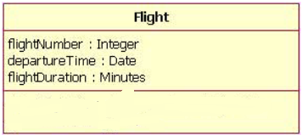
Example
Table: The Flight class's attribute names with their associated types
Attribute Name Attribute Type
flightNumber Integer
departureTime Date
flightDuration Minutes
Notes:
Figure shows an airline flight modeled as a UML class. As we can see, the name is Flight, and in the middle compartment we see that the Flight class has three attributes: flightNumber, departureTime, and flightDuration.
Continuing with our Flight class example, we can describe the class's attributes with the attribute type
information, as shown in Table.

Slide 22
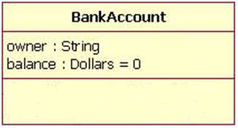
example
Figure shows a Bank Account class with an attribute called balance, which has a default value of 0.

Slide 23
Operations
Operation
is the implementation of a service that can be requested from any object of the class to affect behavior.
It is like methods in Java.
describe what the class can do.
has knowledge about the state of a class and the nature of its associations
The action performed by an operation is based on the current values of the attributes of a class
A class may have any number of operations or no operation at all.
can either be a command or a question. Only a command can change the state of the object, a question should never change it.
It has a name and a list of arguments.
An operation’s name is written in the exact way as the attribute.
The list of operations begins below a line separating operations from the attributes.

Slide 24
Operations
Four categories of operations
Operations that manipulate data in some way to change the state of an object (e.g., add, delete, modify)
Operations that perform a computation
Operations that inquire about the state of an object
Operations that monitor an object for the occurrence of a controlling event

Slide 25
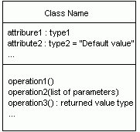
Operations
The syntax for operations is name [ (parameter-list ) ] [ : return-type ]
parameter-list syntax [ direction ] name : type [ = default-value ]
direction
in—input parameter; may not be modified
out—output parameter; may be modified
inout—input parameter; may be modified

Slide 26

example
The Account is the name of the class representing the definition of an Account.
The Value is an attribute of the Account representing the amount of money in the account.
Withdraw and Deposit are methods to Add/Delete money to the account.
The void after the colon are the return types from the class.

Slide 27
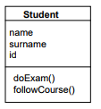
example

Slide 28
Topic 3: Class diagram relationships

Slide 29
Relationships
The UML provides graphic symbols to represent the following relationships between classes:
dependencies
generalizations
Associations

Slide 30
Dependency
Dependency
is a weaker form of relationship which indicates that one class depends on another.
exists when one class relies on another in some way, usually by invoking the methods of the other
is a relationship between two classes in which a change to one, called the independent class, causes a change in the other, called the dependent class.
is represented by a dashed line from the dependent class to the independent class.
exists if a class is a parameter variable or local variable of a method of another class
Dependent Class
Independent
Class

Slide 31
Dependency example
For example, if you have a CDPlayer player class and a RemoteControl class, you would indicate the dependency by the following diagram

Slide 32
Generalization
A Generalization follows a “is a” or “is a kind of” heuristic from a specialization class to the generalization class. (e.g., student “is a” person, video “is a kind of” inventory)..
A relationship between a general thing (called the superclass or parent) and a more specific kind of that thing (called the subclass or child)
The supertype in the generalization relationship is also known as the "parent", superclass, base class, or base type.
The subtype in the specialization relationship is also known as the "child", subclass, derived class, derived type, inheriting class, or inheriting type.
Common attributes, operations and relationships are located in the generalization class and are inherited by the specialization classes
Unique attributes, operations and relationships are located in the specialization classes.
Inherited attributes and operations may be overridden or enhanced in the specialization class depending on programming language support.
Every instance of a subtype must also be an instance of its supertype

Slide 33
Generalization
A class
may have zero, one, or more parents
that has no parents and has one or more children is called a root class or a base class
that has no children is called a leaf class
Inheritance
a class with exactly one parent uses single inheritance
a class with more than one parent uses multiple inheritance

Slide 34
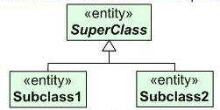

Notation of Class Diagram: Generalization
Graphically, it is rendered as a solid directed line with a hollow arrowhead that points from the child element to the parent element pointing to the parent
The generalization is drawn from the subclass class to the superclass/parent class.
The terms “ancestor” and “descendent” may be used instead of “superclass” and “subclass.”

Slide 35
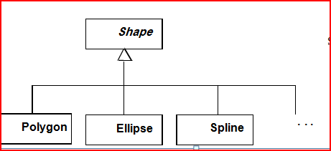
Generalization examples
The generalization is depicted by the following diagram
Notes:
For example, suppose you have a GraduateStudent class and a Student class.
Example: Polygon and Ellipse are specializations of Shape

Slide 36
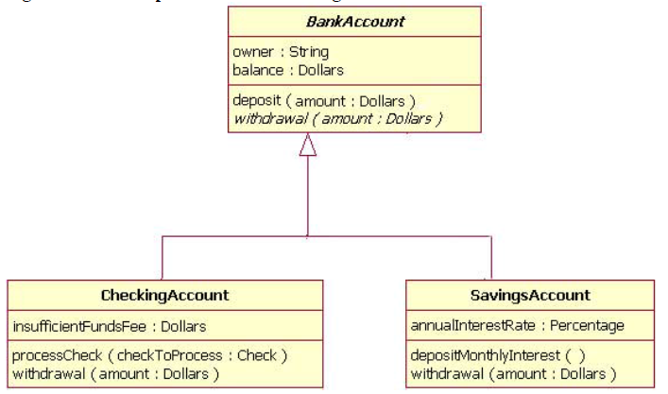
Generalization example
Notes:
Figure shows how both
CheckingAccount and SavingsAccount classes inherit from the BankAccount class.

Slide 37
Generalization example
generalization
Vehicle
subclass
superclass
vehicle-type
Van
Car
Truck
superclass
discriminator
car-size
Compact
Midsize
Full-size
subclass
specialization
discriminator: an attribute of enumeration type that indicates which property of a class is being abstracted by a generalization
Notes:
Please see slide animation

Slide 38
MULTIPLE INHERITANCE EXAMPLE
University
member
id
Student
Employee
Undergrad
Postgrad
Staff
Faculty
TA
Notes:
Multiple inheritance means that a class can inherit from several other classes.
Multiple inheritance is represented by arrows drawn from the subclass to each of the super classes. The class Teaching Assistance (TA) inherits features from both postgraduate and staff.
NB: check slide animation

Slide 39
Association
An association
is a structural relationship within which objects belonging to two or more different classes are connected to each other.
express the relationship between instances of the two classes.
There is an association between two classes if an instance of one class must know about the other in order to perform its work.
are inherently bi-directional.
The name of the association is written along side the association line.
Graphically, it is rendered as a solid line connecting the same or different classes
An arrowhead may be placed on the association line to indicate the reading direction of the association.
The arrowhead should not be misunderstood to be indicating the direction of a pointer implementing an association.

Slide 40

Example
Association between two classes
Notes:
The association of fig. should be read as “Many books may be borrowed by a Library Member”.
NB: this figure is supposed to be presented with the previous slide but there wasn’t a place to put without hiding some text behind it

Slide 41
Association
An Association
represents a family of links
can be named, and the ends of an association can be adorned with role names, ownership indicators, multiplicity, visibility, and other properties
Binary associations (with two ends) are normally represented as a line, with each end connected to a class box
Higher order associations can be drawn with more than two ends; in such cases, the ends are connected to a central diamond
There are five different types of association;
bi-directional and
uni-directional associations are the most common ones
There are instances of associations, just as there are instances of classes
Instances of a classes are called objects;
Instances of associations are called links in UML

Slide 42

Association Notation
Connect two classes
Have an optional label
Have multiplicities
Are directional
Have optional roles

Slide 43
Association Notation
Bi-directional association Associations are assumed to be bi-directional
notation:
Uni-directional association
notation:
-"direction reading arrow"
-it has
no
meaning except to indicate direction of
reading the association label
-often excluded
Employee
1
works-for
4
1
Company
multiplicity
Association name

Slide 44
Association Names
Associations may be named (or labeled)
an association can have a name, and the name is used to describe the nature of the relationship
The names should communicate the meaning of the links
In the same sense that classes correspond to nouns, associations correspond to verbs phases
The name should include an arrow indicating the direction in which the name should be read
works for
Person
Company
employs

Slide 45
Associations Properties
Association properties include
Multiplicity
Role
Constraints

Slide 46
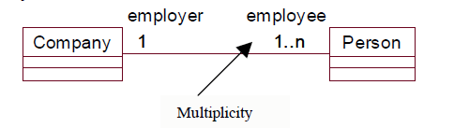
Association Multiplicity
Multiplicity:
Also known as cardinality
Multiplicity is the number of instances of one class relates to ONE instance of another class.
Multiplicity must be defined on both ends of the association.
For example, a company has one or more employees, but an employee works for only one company..

Slide 47
Association Multiplicity
Multiplicity is indicated by a text expression on the role. The expression is a comma-separated list of integer ranges.
This table gives the most common multiplicities
Multiplicities | Meaning
0..1 | zero or one instance. The notation n . . m indicates n to m instances.
0..* or * | no limit on the number of instances (including none).
1 | exactly one instance
1..* | at least one instance
2, 4..6 | Multiple, disjoint ranges
2..4 | Specified range

Slide 48
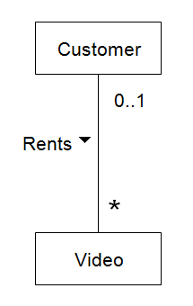


Multiplicity examples
Figure 1
Figure 2
Figure 3
Notes:
Figure 1: One instance of a Customer may be renting zero or more Videos.
One instance of a Video may be being rented by zero or one Customers
Figure 2: Each (individual) Order is associated with zero to many Order Line Items;
Each (individual) Order Line Item is associated with exactly one Order
Figure 3: Each (individual) Order is associated with zero or one Date Received;
Each (individual) Date Received is associated with zero or many Orders.

Slide 49
Association Roles
An association role
is simply an end of an association where it connects to a class.
The role is part of the association, not part of the class.
Each association has two or more roles.
Most of the interesting information about an association is attached to its roles.
Role names:
are necessary for associations between two objects of the same class.
clarifies the purpose an object serves in an association.
is a string near the end of the path.
indicates the role played by the class attached to end of the path near the rolename.
is optional but not suppressible.

Slide 50
Association roles
role B
Class A
Class B
role A
Example:
Employee
Company
Person
Employer

Slide 51
Types of Association
Unary association
both ends of an association circle back to the same class
Binary association
an association that connects exactly two classes
N-ary association
an association that connects more than two classes

Slide 52
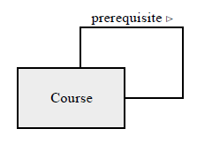
Unary association
a relationship between two different objects belonging to the same class
‘Course is a prerequisite for (a different) Course
Person
Manages

Slide 53
Binary Associations
A relationship between two different classes; Indicated with a line between classes
Person
u Teaches
Course

Slide 54
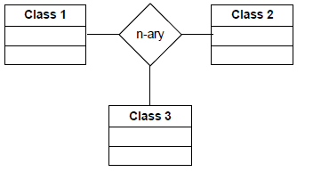
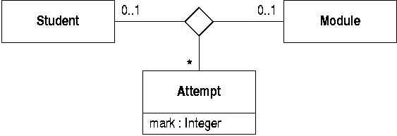
N-ary ASSOCIATION
N-ary associations model relationship among three or more classes.
Lines extending from a diamond are used to connect the classes involved in an n-ary association.
Binary associations are preferred over n-ary associations since they are easier to understand.
N-ary associations are typically implemented as multiple binary associations.
In practice, the vast majority of associations are binary
Notes:
Example: specifies that each pair of student and module object can be linked to zero or more Attempt objects.

Slide 55
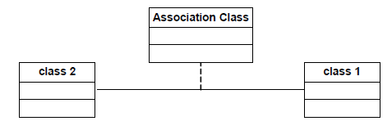
Association Class
An association class:
is an association that is also a class.
is a construct that allows an association connection to have operations and attributes.
features belong to the relationship itself and not any of the classes.
represents attributes and operations that exist only because the association exists.
is rendered by a dashed line from the association to the class rectangle.

Slide 56
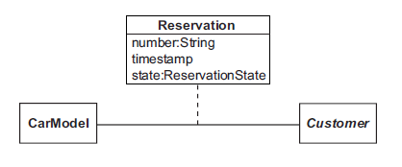
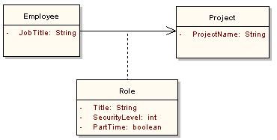
association class Examples
Example 1
Example 2
Notes:
An association class can be introduced alongside the association, as depicted in Figure. This diagram indicates that a CarModel can be associated with any number of Customer objects and a Customer can be associated with any number of CarModel objects. For each link, there is a corresponding Reservation object that has a number, time-stamp and state. There is no name given to the association in this case, because it is implicit in the name of the association class.
In the example above, when a customer makes a reservation, a new link is created at run time between the Customer and the corresponding CarModel.
The other example illustrates, an employee may be working on several projects at the same time and have different job titles and security levels on each.

Slide 57
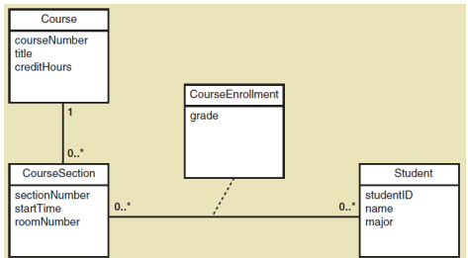
Association Class
Association class— an association that is treated as a class in a many to many association because it has attributes that need to be remembered (such as grade)

Slide 58
Navigation
The navigation of associations can be
uni-directional
bi-directional
unspecified
Navigation is specified by the arrow, not the label
Navigability determines the direction in which a relationship can be traversed
teaches>
Class Section
Instructor
<works for
is instance of>
sponsors>
Department
Course

Slide 59
Aggregation relationship
Aggregation:
is a special type of association where the involved classes represent a whole-part relationship.
represents a relation “contains”, “is a part of”, “whole-part” relation.
can occur when a class is a collection or container of other classes, but where the contained classes do not have a strong life cycle dependency on the container—essentially, if the container is destroyed, its contents are not
As a type of association, an aggregation can be named and have the same adornments that an association can
There are many examples of compositional relationships: a Library contains Books, Departments are made up of Employees, a computer is composed of a number of Devices. To model an aggregation, the aggregate (Department) has an aggregation association to the its constituent parts (Employee).

Slide 60
Aggregation Notation
In UML, it is graphically represented by A hollow diamond is attached to the end of an association path on the side of the aggregate (the whole) to indicate aggregation.
In this diagram class 1 contains classes 2 and 3. Classes 2 and 3 are part-of class 1.
Container Class
Class 1
AGGREGATION
Class 2
Class 3
Containee Classes
Whole
Part
1
1
0..1
0..1
An aggregation relationship that has a multiplicity greater than one for the aggregate

Slide 61
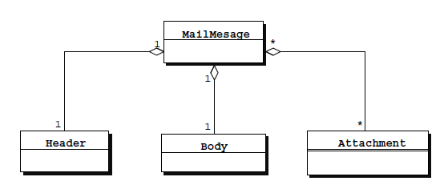

Aggregation examples
Notes:
Figure1 shows a typical example of aggregation, in which an electronic mail message contains a header, a body and an unspecified number of attachments.
Figure 2 shows an example of an aggregation relationship between a Car and a Wheel.

Slide 62
Aggregation example
Hierarchy (Aggregation)
Computer
I/O Devices
CPU
Memory
Cache
ALU
Program
Counter

Slide 63
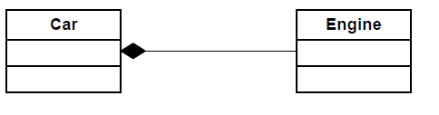
Composition
Composition:
is a special kind of aggregation which does impose some further restrictions.
Composition is a stronger variant of the "owns a" or association relationship.
Composition is really a strong form of association
components have only one owner
components cannot exist independent of their owner
components live or die with their owner
e.g. Each car has an engine that can not be shared with other cars.
composition
Car
aggregation
Engine

Slide 64
composition Notation
The UML graphical representation of a composition relationship is a filled diamond shape on the containing class end of the tree of lines that connect contained class(es) to the containing class
Whole Class
Class W
Class P₁
Class P₂
Part Classes

Slide 65
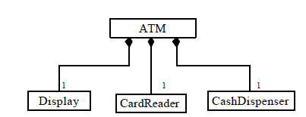
Composition example
The relationship shown here means that there is only one ATM class. The Display, CardReader and CashDispenser can be associated with at most one ATM

Slide 66


Composition examples
Order
Entry
+items
1
*
Notes:
1)For example, the relationship between a person and his head , body, arm and leg is a composition relationship
2)Figure, a Company class instance will always have at least one Department class instance. Because the relationship is a composition relationship, when the Company instance is removed/destroyed, the Department instance is automatically removed/destroyed as well.
3)Third example Composition implies that an Order is comprised of Entry parts (an Order logically does not exist without any Entry objects), and that the Entry objects cannot exist independently of the Order object; that is, the Order exclusively owns the Entry objects.

Slide 67
Aggregation and Composition
Order
1
1
shows
aggregation
shows
composition
1
1
1
Shipping
Information
Billing
Information
1..*
Book
Notes:
This figure shows that an Order contains Shipping Information in which each Order instance has only one Shipping Information.
Also, an Order instance comprises an instance of Billing Information and one or more instances of Book in the essence that if the Order instance is removed or destroyed, the Billing Information and Book instance(s) are removed removed or destroyed

Slide 68
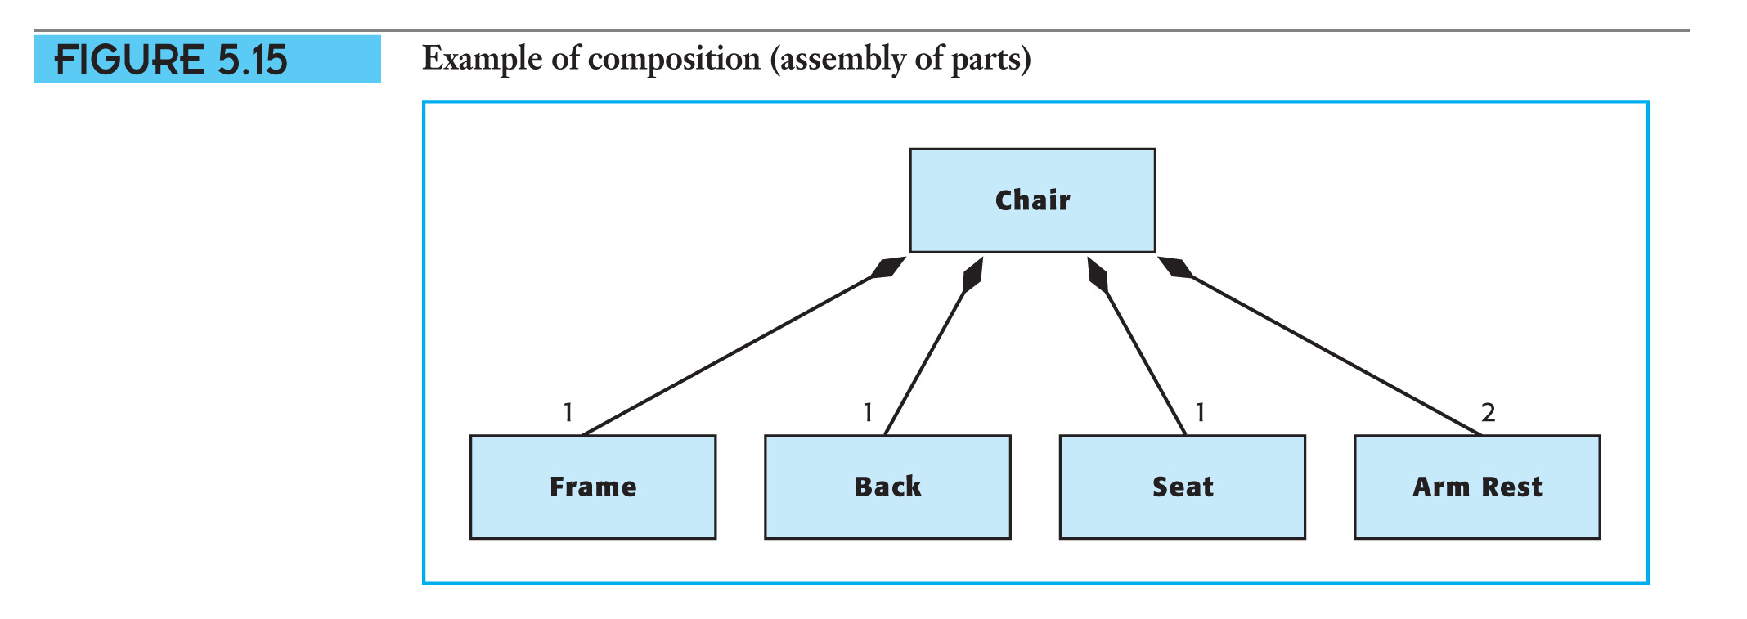
Example of a Composition
.
Notes:
This figure shows that the chair is a composition of Frame, Back, Seat and Arm Rest

Slide 69
Aggregation vs. Composition
Composition is really a strong form of aggregation
components have only one owner
components cannot exist independent of their owner
components live or die with their owner
e.g. Each car has an engine that can not be shared with other cars.
Aggregations may form "part of" the aggregate, but may not be essential to it. They may also exist independent of the aggregate.
e.g. Apples may exist independent of the bag.

Slide 70
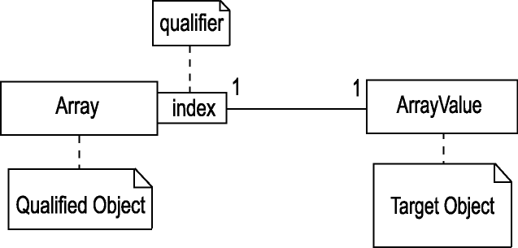
QUALIFIED ASSOCIATION
Attribute or attributes used to partition a set of instances across an association
A qualifier is used within a qualified association to relate a qualified object to a target object using a qualifier value from a set of qualifier values.
A qualified association can be used to refine the multiplicities of an association by specifying an attribute through which the association is made

Slide 71
Qualified Association Examples:
Without qualification
1
*
File
Directory
filename
With qualification
1
0…1
Directory
filename
File
Qualifiers can be used to reduce the multiplicity of an association.
For example, consider the one-to-many association between DOS files and directories. The Filename qualifier reduces this to a many-to-one association as illustrated in Figure

Slide 72
Qualified Association Examples:
1
1
*
Order
0..1
Order line
product
1
1
1..2
Team
10
Player
position

Slide 73
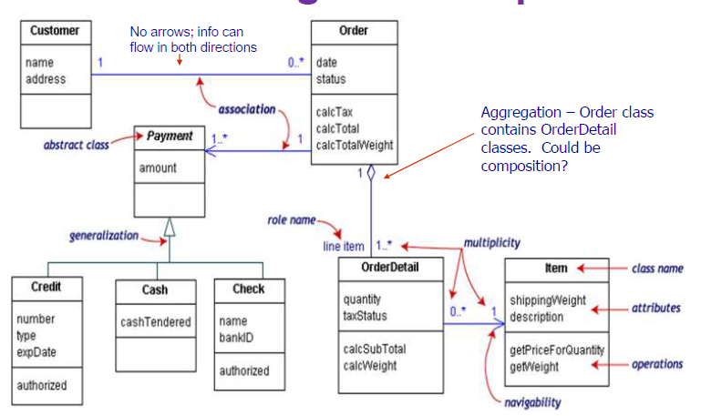
Class Diagram Example

Slide 74
Structural Modeling: Core Relationships

Slide 75
Topic 4: University Course Registration System … class diagram

Slide 76
Class diagram
RegistrationForm
ScheduleAlgorithm
0..*
1
RegistrationManager
addStudent(Course, StudentInfo)
Course
1
RegistrationUser
0..*
name
numberCredits
name
Student
open()
major
addStudent(StudentInfo)
1
3..10
Professor
1..*
4
CourseOffering
tenureStatus
1
location
0..4
open()
addStudent(StudentInfo)
Notes:
34
The above diagram shows the class diagram of University Course Registration System.
This system encompasses 8 classes connected to one another.
Student, having major attribute, inherits from RegisterationUser,having attribute name and is connected to CourseOffering,having attribute location and addStudent(Course,StudentInfo) method in which each 3 to 10 Student instances have 4 CourseOffering instances.
Similarly, Professor, having tenureStatus attribute, inherits from RegisterationUser and is connected to CourseOffering in which each Professor instance has from 0 to 4 CourseOffering instances.
An instance of Course, having name and numberCredits attributes and open() and addStudent(StudentInfo) methods, consists of one or more instances of CourseOffering
0 or more instances of RegisterationForm links to a single instance of RegisterationManager, having addStudent(Course,StudentInfo) method that is connected to one or more instances of Course.
RegisterationManager depends on ScheduleAlgorithm

Slide 77
Summary
In this lesson , he following points were covered:
• the features represented by a class diagram.
• the relationships among different types of classes by means of association.
• the relationships among different types of classes by means of aggregation.
• the relationships among different types of classes by means of composition.

Slide 78
Activity

Slide 79
Quiz

